Slide 1
Topic: Reading Scales
EQ: how do we read different scales?
Times tables Starter!
10 x 10 grid

Slide 2
Topic: Reading Scales
EQ: how do we read different scales?
What is an interval?
The space between the adjacent markers on a scale
Find out how much each interval is worth above. How did you work it out?

Slide 3
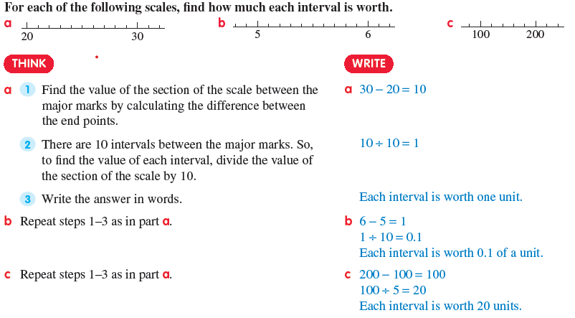
Topic: Reading Scales
EQ: how do we ready different scales?

Slide 4
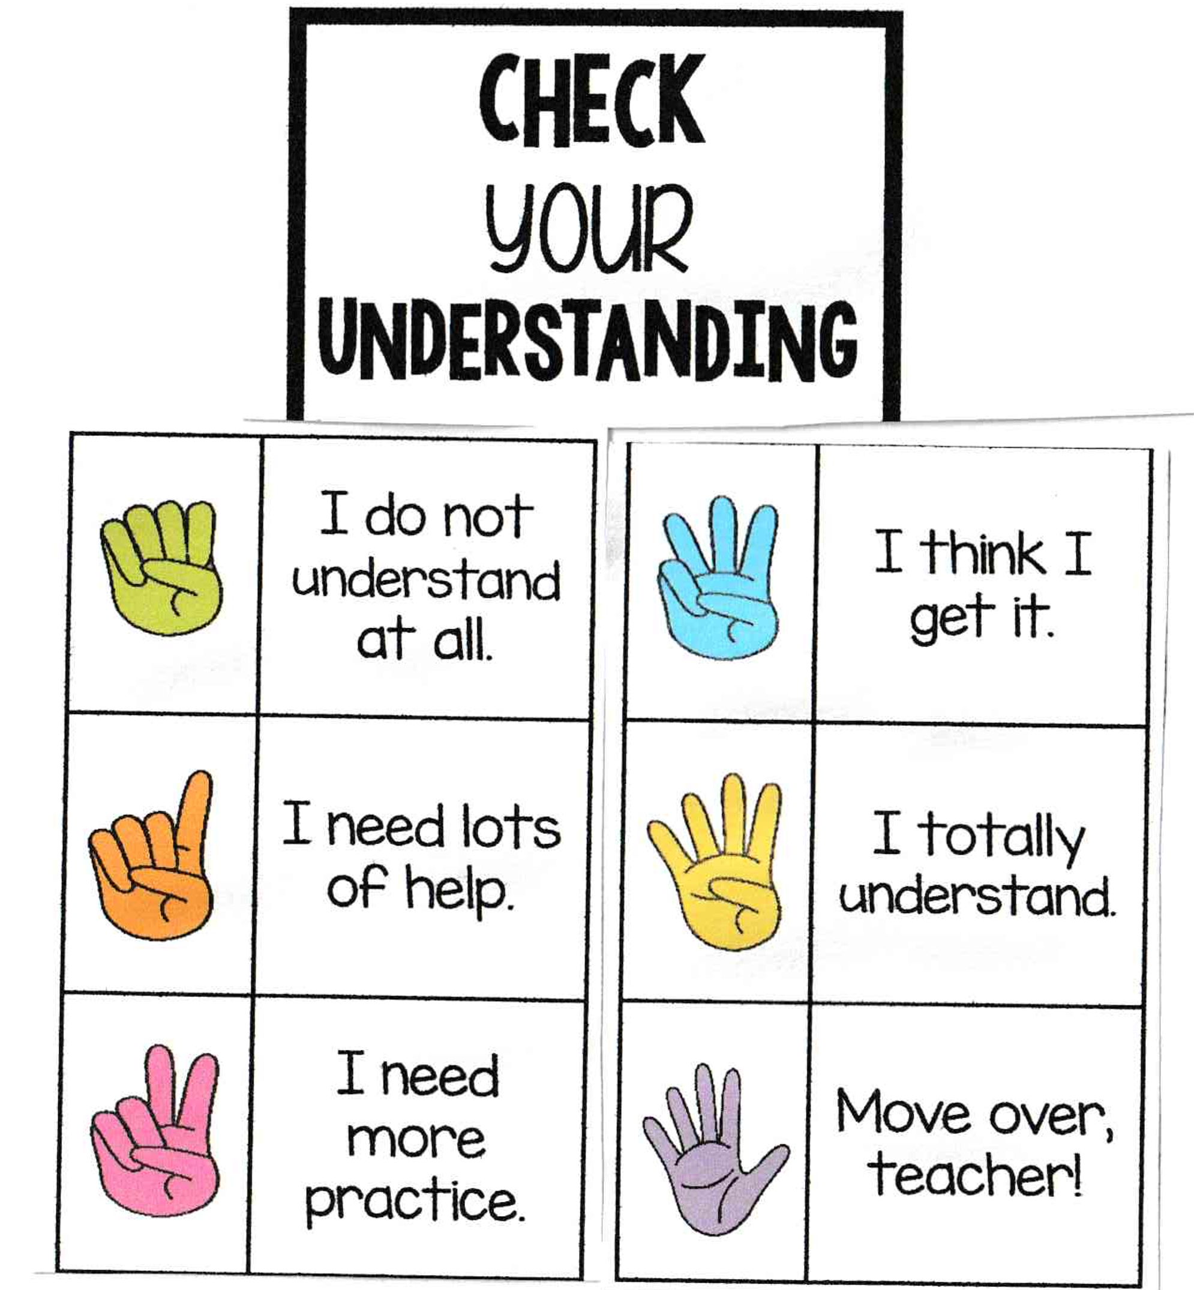

Slide 5
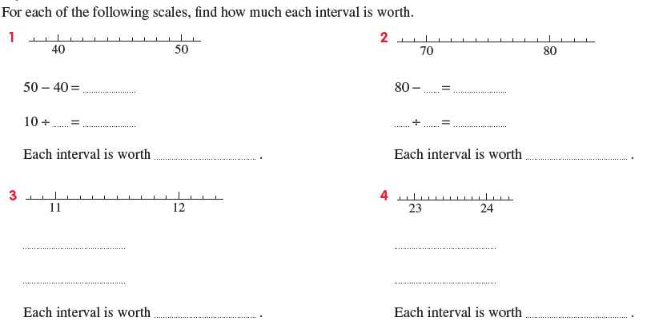
Topic: Reading Scales
EQ: how do we read different scales?
Let’s do problem 1 together
Then do 2-10 independently
(worksheet)

Slide 6
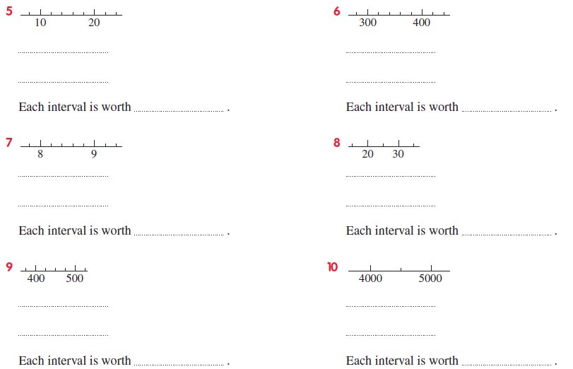
Topic: Reading Scales
EQ: how do we read different scales?

Slide 7
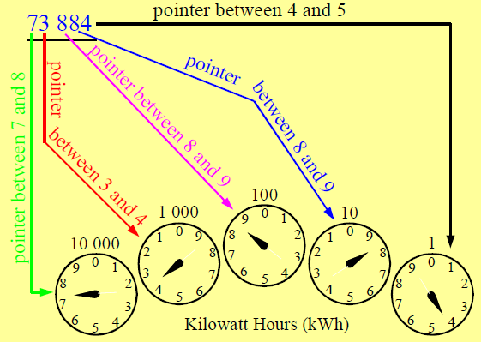
Topic: Reading Scales
EQ: how do we read different scales?
How do we read an electricity meter?
The needle represents the smallest of the two numbers it is between
If the needle is between 9 and 0, 9 is the smallest number (zero = 10)
But if the needle is between 0 and 1, 0 is the smallest number (zero = 0)

Slide 8
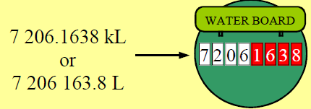
Topic: Reading Scales
EQ: how do we read different scales?
How do we read a water meter?
Water meter is in kL (kilolitres)
Red digits are the decimal places
To find water usage the before reading is subtracted from the after reading

Slide 9
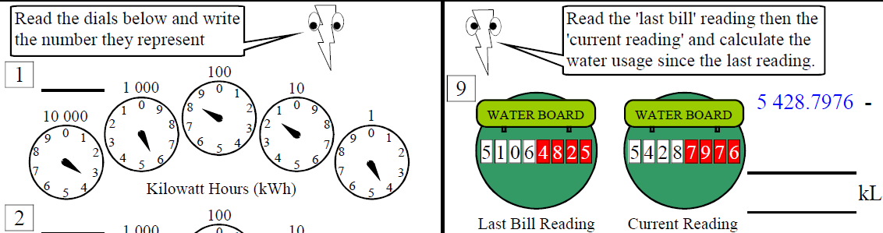
Topic: Reading Scales
EQ: how do we read different scales?
Let’s do these from worksheet together

Slide 10
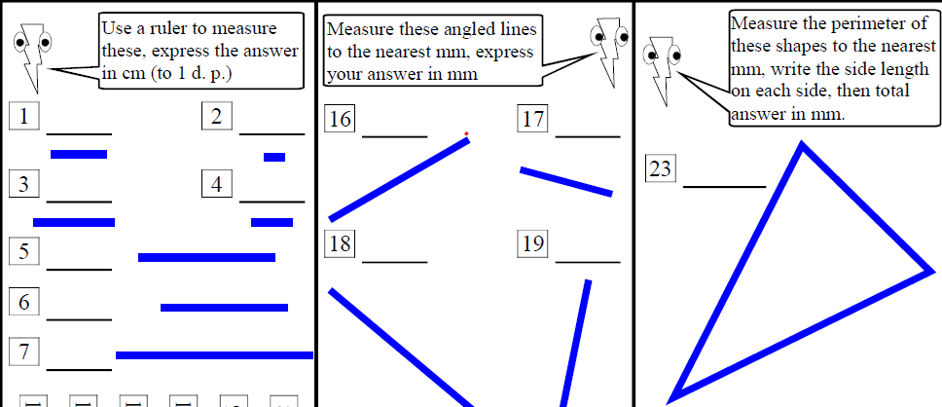
Topic: Reading Scales
EQ: how do we read different scales?
Rulers have both cm and mm on them, so you use the one that is asked for.
To convert there is 10mm in 1cm.
How many mm in 2cm?
How many mm in 12cm?
How many mm in 4.6cm?
How many mm in 14.3cm?
How many cm in 50mm?
How many cm in 110mm?
How many cm in 67mm?
How many cm in 157mm?
How do we measure using a ruler?
Get a ruler and do the worksheet, note what the instructions say at the top of the columns

Slide 11
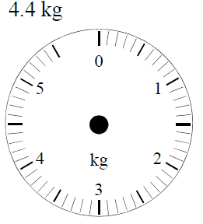
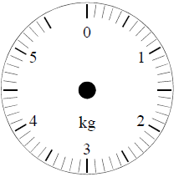
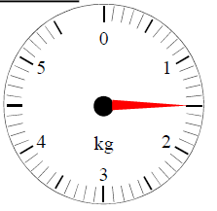
Topic: Reading Scales
EQ: how do we read different scales?
What is each interval worth on the weight scale shown?
What is the weight shown in the scale? (red pointer)
Where would the pointer go to show:
Now do the worksheet on reading weight scales ☺

Slide 12
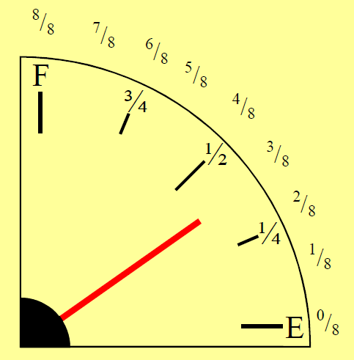
Topic: Reading Scales
EQ: how do we read different scales?
How do we read a fuel gauge?
Fuel gauge indicates how much fuel in car
Usually shows ¼, ½, 3/4, empty and full
To read between these we use ‘eighths’, but these aren’t usually seen on your gauge
Often we look at this to decide when to stop for fuel and mentally calculate how many km left
Newer cars can actually tell you this!

Slide 13
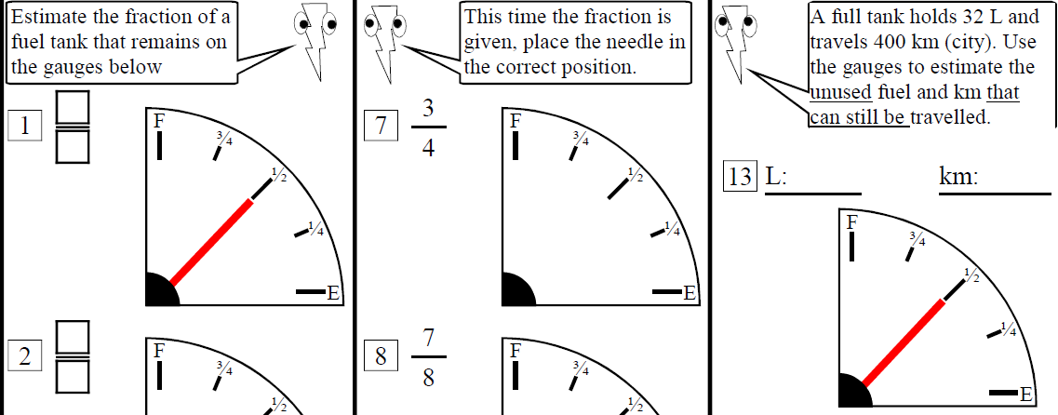
Topic: Reading Scales
EQ: how do we read different scales?

